Slide 1
SOST – 2220.03 : Introduction to Population Studies
Kanthi Manel
Senior Lecturer
Department of Social Statistics
University of Sri Jayewardenepura

Slide 2
Components of Demographic analysis
Mortality
Demographic components
Migration
Fertility
Notes:
You know already what are the main components of demographic basically that we should learn. In this diagram you can see main demographic components are Mortality, fertility and migration.

Slide 3
Introduction to Demography
The term demography has been derived from two Greek words, Demos means the people while graph means to draw or to write. So, literally speaking, demography is concerned about writings about people. Different demographers and sociologists have given their own definitions as under.
Donald J. Bogue (1969), Demography is the mathematical study of size, composition and special distribution of population and of changes through the operation of the five processes of fertility, mortality, marriage, migration and social mobility.
Benjamin (1751) - Demography is concerned with the measuring of the past and future population change and for this purpose the demographers must quantify the elements of fertility, mortality and migration as well as social and economic influences.
Thompson & Lewis : The demographic studies is concerned with the population, its size, composition and distribution and in changes in these aspects through time, and the causes of there changes as they are related to human welfare.

Slide 4
Cont.…
W.G. Barkley Demography dies not deal with the behavior of individuals but with the aggregate of people or ever parts. The numerical portrayal of human population is known as demography.
It has been concluded from the above definitions that, demography is the study of population variables like fertility, mortality and migration to know about the size, distribution and fluctuation (rise & fall) in population.
Hauser and Duncan (1959:2), Demography is “the study of the size, territorial distribution, and composition of population, changes therein, and the components of such changes.”
Study of both quantitative and qualitative aspects of human population. Quantitative aspects include composition, density, distribution, growth, movement, size and structure of the population. Qualitative aspects are the sociological factors such as education quality, crime, development, diet and nutrition, race, social class, wealth and well being

Slide 5
What are sources of demographic data?
Vital statistics registration system
National censuses
National Sample surveys
Disease registries or surveillance systems
Health system records
Cross-national data
Notes:
Before we learn about the components of demographic we should remind the demographic data sources. Last time we discussed about the data sources of population studies. Here also I mentioned some of them. Although we named as demographic data, all these data can be used to describe the population in a country. Can you remember on by one we have discussed

Slide 6
What do you know about History of demography?
Ancient Chinese
Confucius
Greek philosophers
Aristotle , Plato
John Graunt (1620-1674)

Slide 7
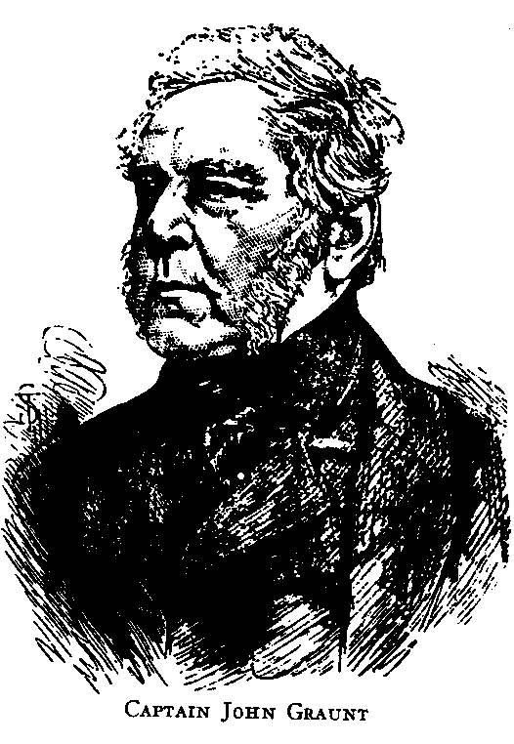
History of Demographic analysis
John Graunt (1620-1674)
Cloth merchant
His book (1662) ‘Natural and Political Observations Made Upon the Bills of Mortality’ marks the beginning of mortality analysis
Founder of demography

Slide 8
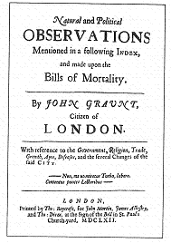
Grunt’s ‘observations’
Title page of Grunt’s ‘observations’
Grunt used weekly list of deaths ‘bills of mortality’ from the plague, which were collected by parish priests in London
His investigation of mortality by causes of death
Source: Graunt , (1662,) cited by Rowland D.T, 2006:15).062003RR

Slide 9
Grunt’s ‘observations’ of Demographic data (cont...)
sex ratio
population growth and its components
survival proportions at different ages
innovation of first life table

Slide 10
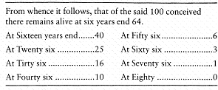
Table1: Grunt’s survival table for London
Source: Grunt (1662: 69-70) cited by Rowland D.T, ( 2006:267)062003RR

Slide 11
Cross-national data
Include comparative data on mortality published by the organizations like the United Nations (e.g. Demographic Yearbook)
The World Health Organization (e.g. World Health Statistics Annual)
Data is used for analyzing regional patterns of mortality and morbidity
Notes:
These data has various type of data relevant to several or many countries. As an example United Nations collects data regarding aging population or child population. If they want to find the amount of aging population, decrease or increase the aging population we compared with before 10 years and the current year.

Slide 12
Cont…
Hally (1656-1742)
invented the term “Expectation of Life” and constructed detailed life table
Bernoulle (1700-1782)
used Halley’s life tables to study , small pox.

Slide 13
Cont..
Johann Peter Suessmilch (1707-1767)
wrote the first comprehensive book on population entitled “The divine order in the changes of human race shown by its birth, death and reproduction”
constructed a life table or universal applicability using Swedish, German and French data

Slide 14
Cont…
Thomas Robert Malthus (1766-1834)
study on the relationship between food and population growth in his essay published in 1798 entitled “An Essay on the Principles of Population”
This publication was revised in as second edition in 1803 and further revised in 1806, 1807, 1817 and 1826 and 1872 (second edition)
His focus was mostly on fertility and reproduction
Thomas Robert Malthus is generally considered to be the father of substantive demography.

Slide 15
Cont…
E.G. Ravenstein’s (1885)
book titled ‘On the Laws of Migration’ was the scientific study on migration
He considered as the ‘Father of Migration’

Slide 16
Discussion
What are uses of Demographic analysis?

Slide 17
Required Readings
Rowland, Donald T., 2003, Demographic Methods and Concepts, Oxford University Press
Swanson, David and Jacob S. Siegel, 2004, The Methods and Materials of Demography, Elsevier Academic Press.

